Slide 1

PlaatEnergy (Energy Data Logger) Open Source Project
W.B.J. van der Plaat
(Software Architect)

Slide 2

Question
How many energy is my house using daily?
How many gas is my heater using daily?
How many energy is my solar system deliver daily?
How many solar power is directly consume by my house?

Slide 3


Idea
Lets create an application which measures everything
Records every minute energy and gas usage
Records every minute energy and solar energy delivered
User friendly Web GUI
Use low cost, low energy hardware

Slide 4
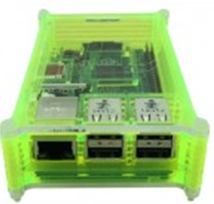
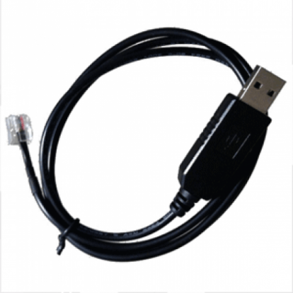
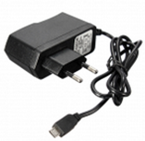
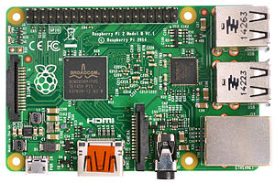

Used Hardware
Raspberry Pi 3B
USB to P1 Cable
Micro SD card (16GB)
USB power supply
Raspberry Pi Case

Slide 5
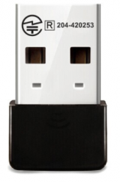

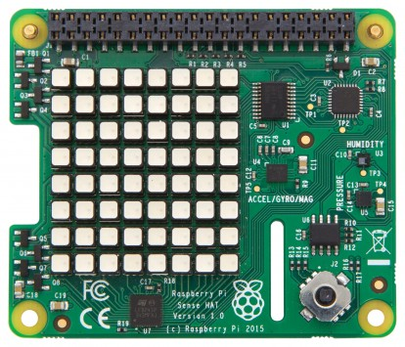
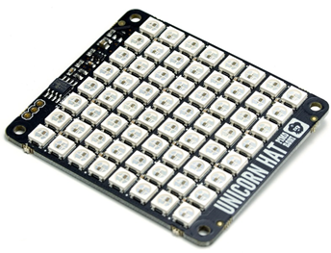
Optional Hardware
Wifi USB Dongle
Bluetooth USB Dongle
Pi Sense Hat
Unicorn Hat

Slide 6

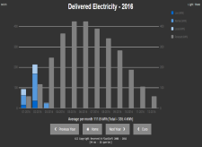
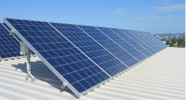


Hardware View – Configuration 1
HDMI
Omnik Solar
Converter
Raspberry Pi
PlaatEnergy
Pi Sense Hat
Wifi
Wifi Router
Ethernet
USB
USB

Slide 7

Hardware View – Configuration 2
P1 cable
Digital Energy
Meter
Bluetooth
Digital Gas
Meter
Omnik Solar
Converter
USB
Raspberry Pi
PlaatEnergy
Sense Hat
Wifi
Wifi Router
Ethernet
Ethernet
ADSL Router
PlaatEnergy
Reachable on
internet
UTP
Internet

Slide 8
Hardware View – Configuration 3
P1 cable
Digital Energy
Meter
Bluetooth
Digital Gas
Meter
Hosola Solar
Converter
Hosola Solar
Converter
Hosola Solar
Converter
USB
Raspberry Pi
PlaatEnergy
Unicorn hat
Wifi
Wifi
Wifi
Wifi Router
Ethernet
Ethernet
PlaatEnergy
Reachable on
internet
ADSL Router
HDMI
PlaatEnergy
slide show
at
monitor
UTP
Internet

Slide 9
PlaatEnergy Software Architecture
Google Charts
Weather Service
JSON
Presentation Layer
PHP/CSS/JS
Apache
Business Logic Layer
PHP
Database Layer
MySQL
Solar Converter
Interface
Energy Meter
Interface
Environment
Interface
Display
Interface
PHP/ Python
Operating
System
Debian Linux
Vendor Support
Omnik
Hosola
Vendor support
Kaifa
Landis
kamstrup
Vendor support
Pi onboard
Pi Sense Hat
Vendor support
Pi Sense Hat
Unicorn Hat

Slide 10
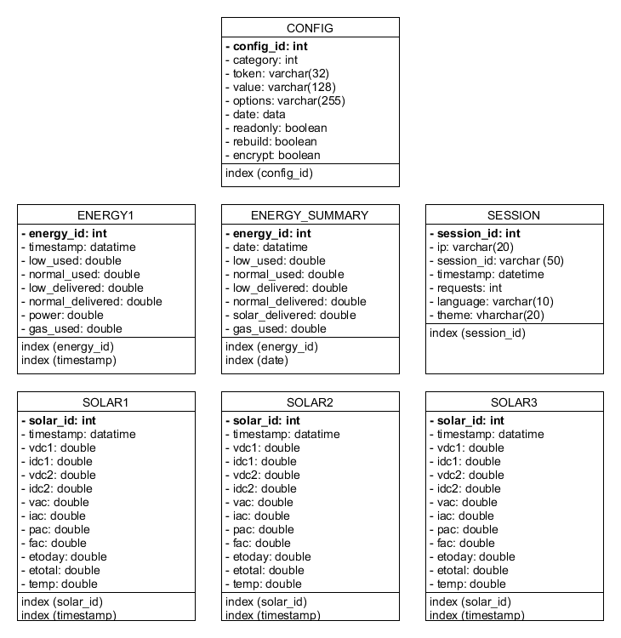
PlaatEnergy Data Model

Slide 11
PlaatEnergy Key Features
Measure each device every minute
User friendly web interface
Show real-time, historical and forecast data
Show financial data
Support measurement corrections
Export measure data to CSV and SQL
Custom Data Report
Automatic upgrading
Secure access to Web GUI and settings
Open Source and free to use!

Slide 12


Slide 13
Conclusion
My energy use is dropped with 25%
My gas use is dropped with 50%
because I am more aware now.
PlaatEnergy is downloaded ca. 130 times “Customers” sending great feedback back ☺
SOS Solutions. One of the biggest Raspberry Pi resellers in the Netherlands will sell soon a Pi Smart Energy Kit with includes PlaatEnergy ☺

Slide 14


Slide 15
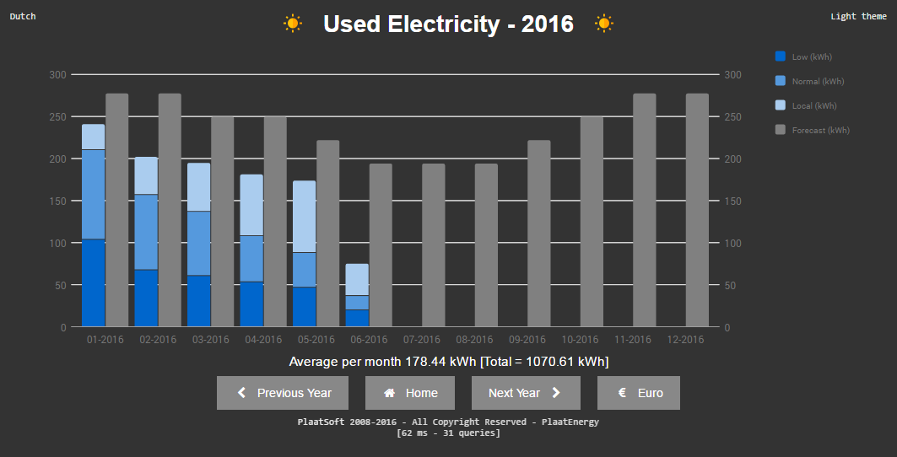

Slide 16
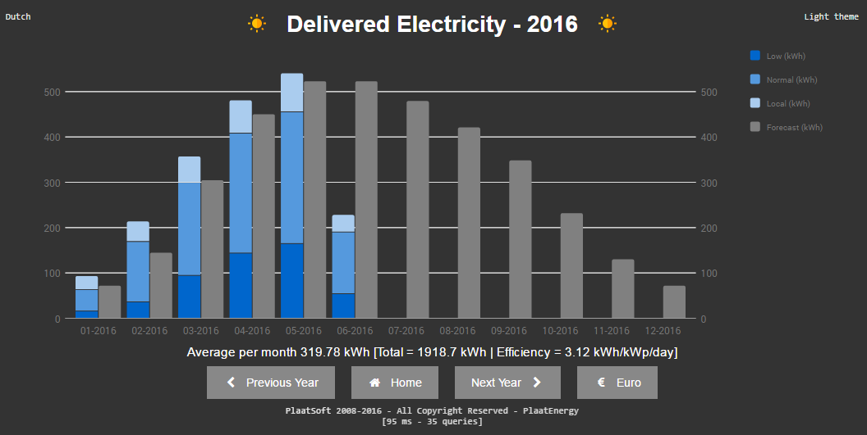

Slide 17
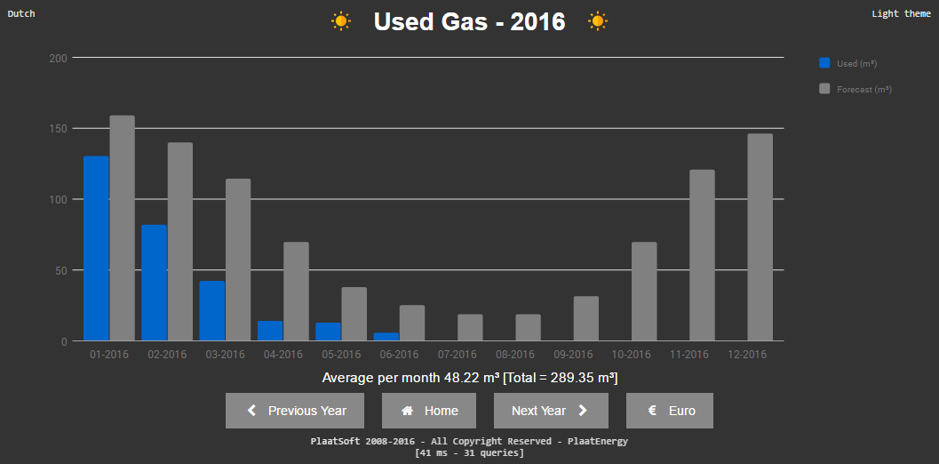

Slide 18
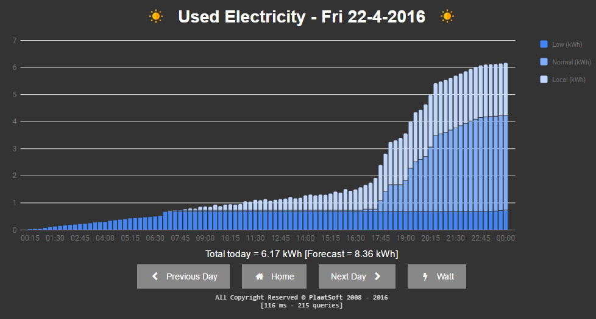

Slide 19
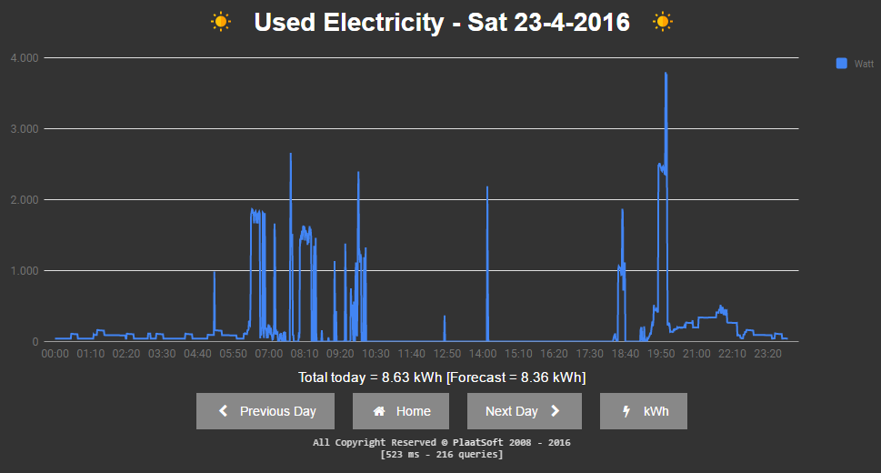

Slide 20
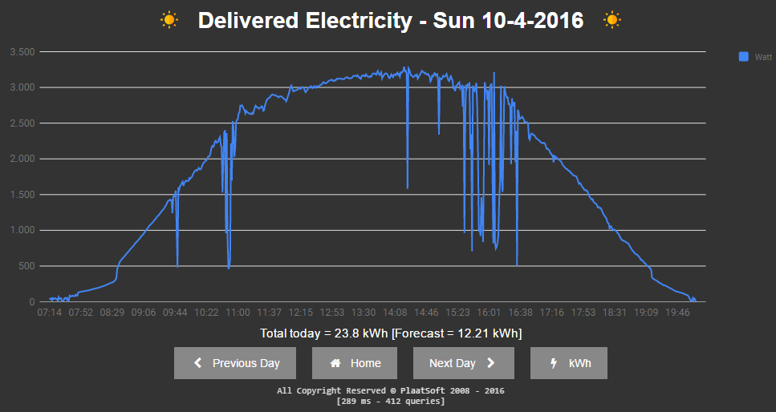

Slide 21
